Slide 1
Error Analysis & Improvement
Steeve Huang

Slide 2
Agenda
Highlight
Error Analysis
Improvement
Better Model
Character-level threshold
Filtering Images
Problem Remains

Slide 3
Highlight

Slide 4
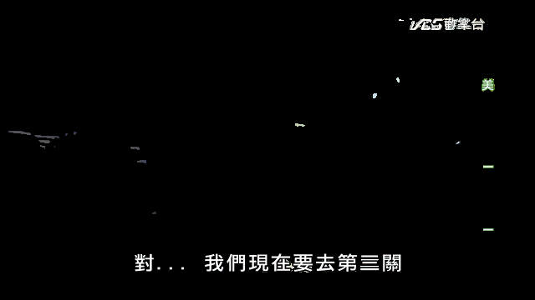
Error Analysis

Slide 5

Error Analysis

Slide 6
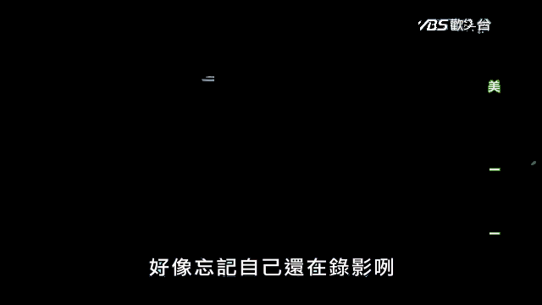
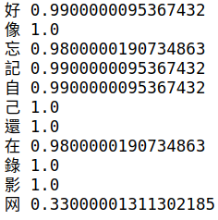
Error Analysis

Slide 7
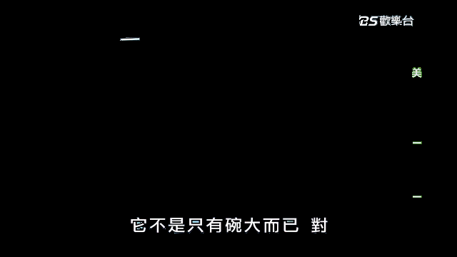
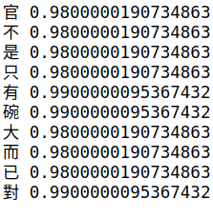
Error Analysis

Slide 8
Improvement
Better models
Character-level threshold
Filtering Images

Slide 9
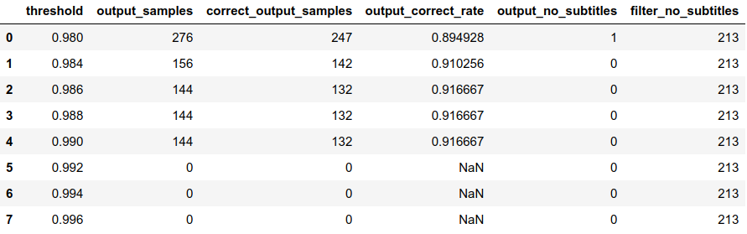
Better Models
Original (Resnet 50)

Slide 10
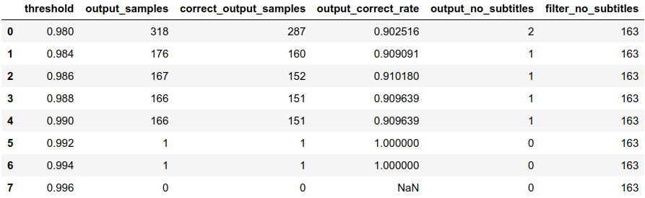
Better Models
Improved (Resnet 101)

Slide 11
Character-level Threshold
Set a confidence threshold for the characters

Slide 12
Character-level Threshold

Slide 13
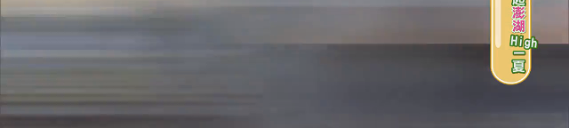

Filtering Images

Slide 14
Filtering Images
t = 1
t = 2
Background Subtraction
t = 3
.
.
.
.
.
.
t = n-1
t = n

Slide 15
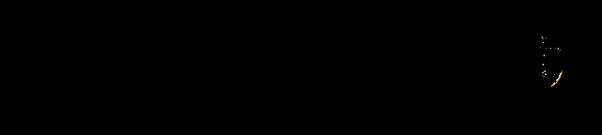
Filtering Images
Background subtraction

Slide 16
Filtering Images
Original:
Filter 62 frames
After BGS:
Filter 459 frames

Slide 17
Next Step
Train a classifier to decide which images to send to Google API.
Start collecting data

Slide 18
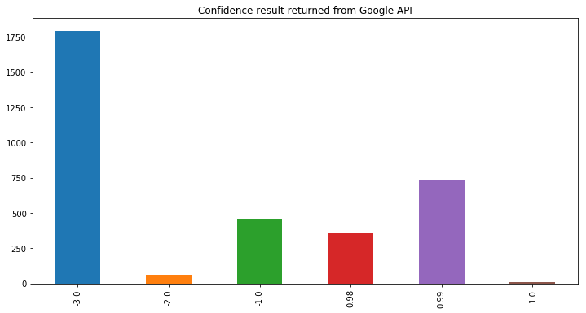
Problem Remains
-1: Filtered images not sent to Google
-2: Images such that Google detect no text
-3: Images containing characters lower than char-level threshold

